Slide 1

UI Design Principles

Slide 2


Slide 3


Slide 4


Slide 5
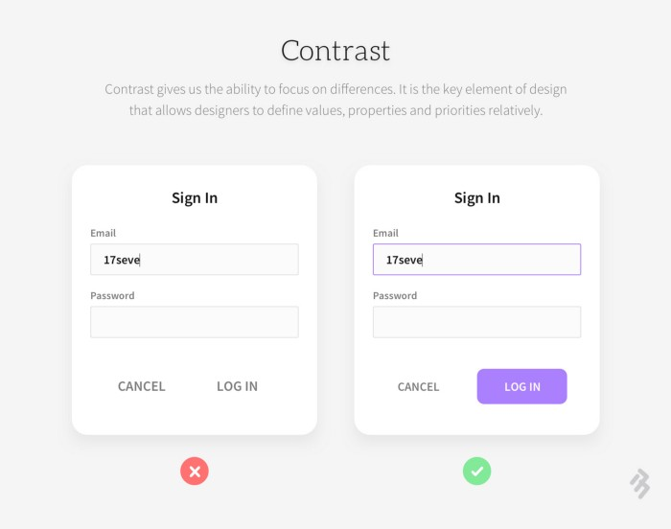

Slide 6


Slide 7


Slide 8


Slide 9
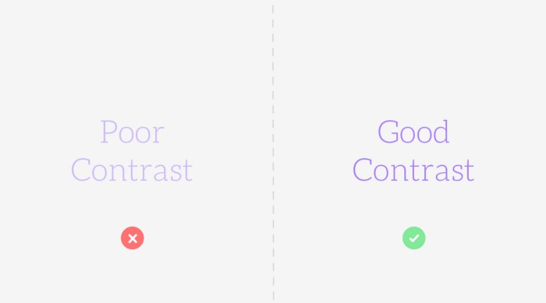

Slide 10


Slide 11


Slide 12
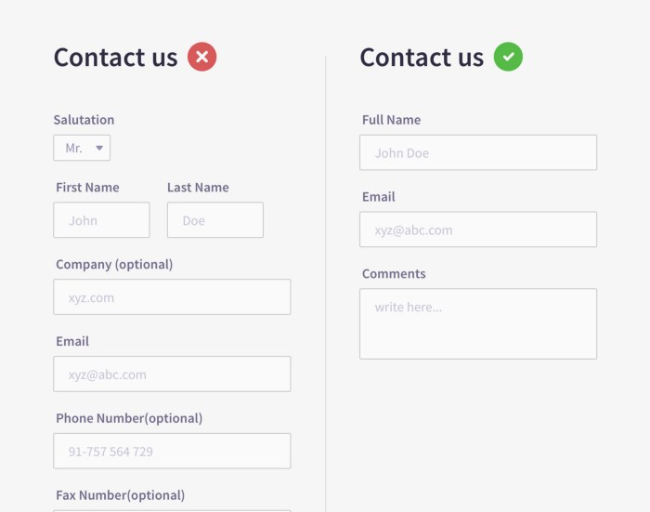

Slide 13


Slide 14


Slide 15
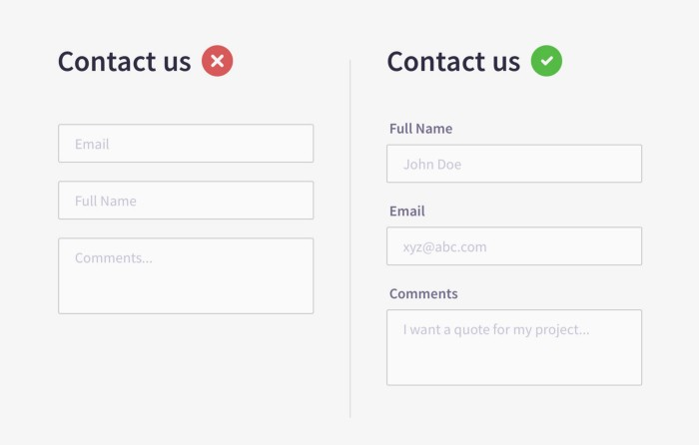

Slide 16
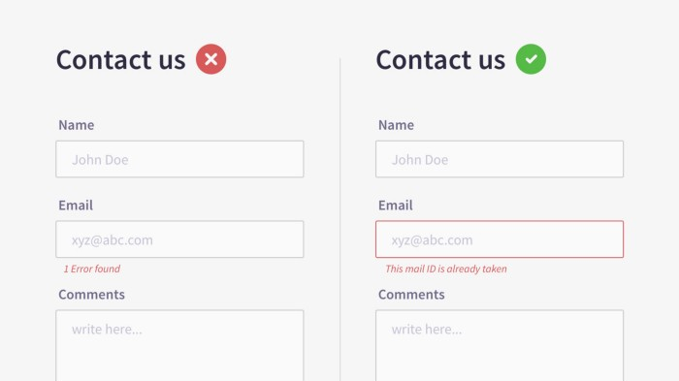

Slide 17
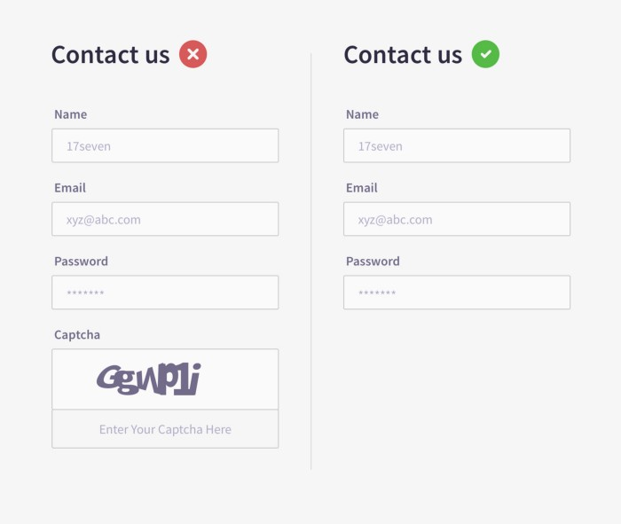

Slide 18


Slide 19
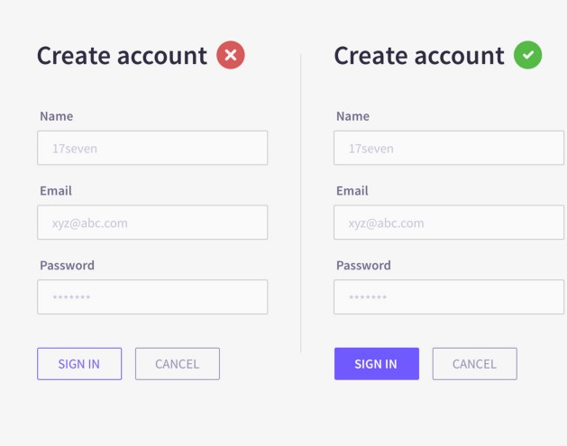

Slide 20

A simple thumb-rule is to keep form design as simple as possible.
Single column and appropriately sized input fields
Break down the input process into logical steps in the right order
Ask only important information
Single column and appropriately sized input fields
Clear input field labels and placeholders
Autofill the data
Intuitive error messages
Avoid captcha
Prominent Optional fields and Clear CTAs

